Slide 1
Deepwriting
How to craft a story with protocol
Stanley Qiufan CHEN
writer
(co-)author of Waste Tide,
AI2041:Ten Visions for our future

Slide 2
What is storytelling?
text
image
metaphor
character
author
reader
plot
meanings
structure
emotion
genre
style
protocols

Slide 3
What is storytelling?
The act of creating a space of
meanings
with using all the elements (text/image/metaphor/character/plot/structure /emotion/genre/style etc.)
under certain protocols
between
the Author and the Reader.

Slide 4
Question: Level of difficulties to change below?
The act of creating a space of
meanings
with using all the elements (text/image/metaphor/character/plot/structure /emotion/genre/style etc.)
under certain protocols
between
the Author and the Reader.

Slide 5
Mechanisms by which protocols deepen meaning:
Layered scaffolding: forces systematic exploration of plot, context, belief, and symbol rather than ad-hoc storytelling.
Constraint-driven focus: embeds clear objectives and checks at each stage, ensuring every element carries thematic weight.
Intent encoding: captures the author’s deeper ambitions (worldview, archetype) so narrative choices align with a cohesive vision.
Reflective prompts: prods writers to surface hidden assumptions and cultural blind spots, turning simple scenes into resonant microcosms.

Slide 6
Question: Level of difficulties to change below?
easy to hard:
elements < meanings < protocols
easy to hard:
author < reader
The better we understand the hard part,
the better we optimize the easy part.

Slide 7
Why Protocols matter?
Developed through time and deeply rooted in culture and humanity；
Shapes the way readers read，understand and feel the story；
Authors are also readers, we write as the way we read;
Lack of protocol thinking will lead to:
-- shallowness (character, plots, emotions, etc.)
-- inconsistency from different layers;
-- empty metaphors without relevancy;
-- explicit propaganda and weak meaning making;
In a word, it is not deep enough.

Slide 8
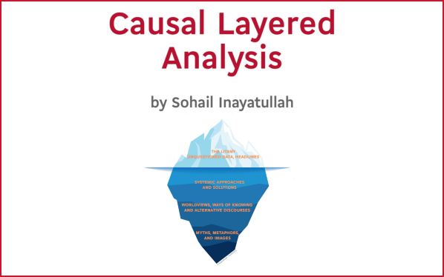
What is CLA? Why it help to craft story?
CLA (Causal Layered Analysis) by Sohail Inayatullah
Litany
the surface narrative: “What happens?”
Systemic Causes
context & systems behind the story: “Why does it happen?”
Worldview/Discourse
underlying beliefs & values: “What assumptions inform it?”
Myth/Metaphor
deep archetypes & images: “What universal story does it echo?”

Slide 9
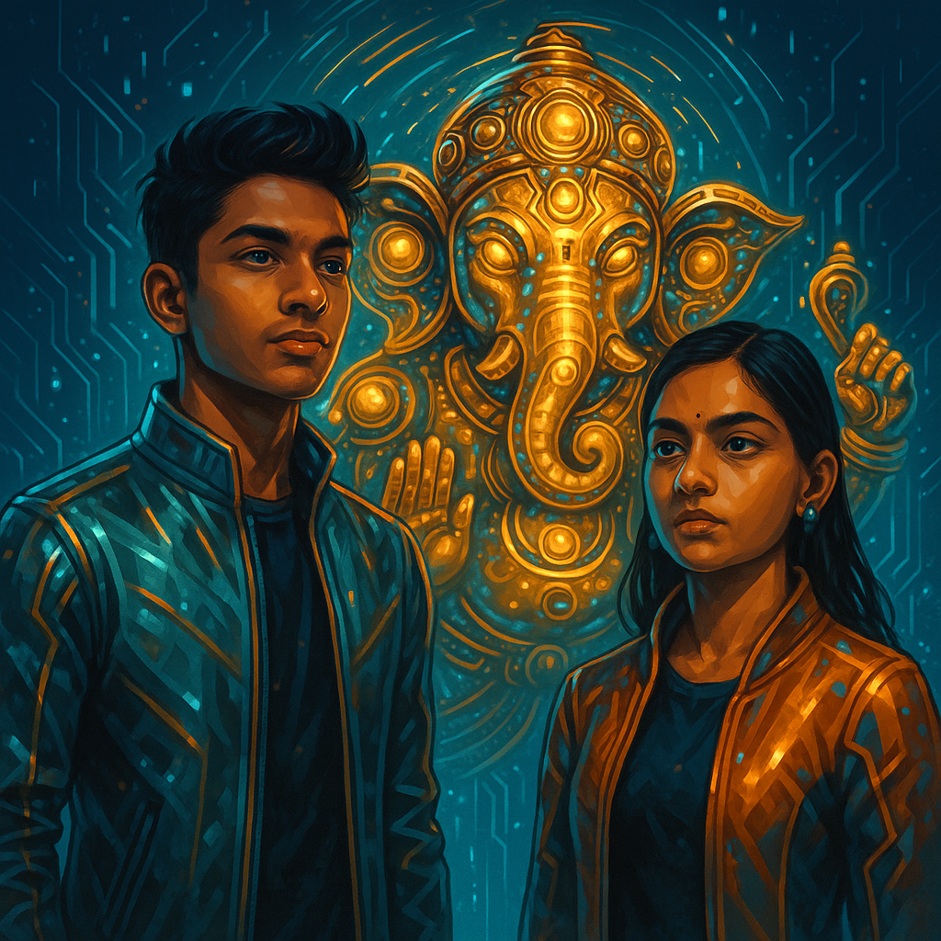
Deep Writing Practice
“The Golden Elephant”
Unfolds in 2041 Mumbai, where teenage Nayana’s family enrolls in Ganesh Insurance—an AI-driven program of apps that uses deep learning to optimize health and safety. As the system nudges them toward “ideal” behaviors, it also subtly discourages Nayana’s romance with Sahej, a boy from a lower caste, exposing how algorithmic insurance can perpetuate social bias. Through virtual classrooms and data-driven insights, the story explores AI’s power to quantify hidden discrimination, raising urgent questions about fairness, autonomy, and ethics in intelligent systems.

Slide 10
Deep Writing Practice
Litany：AI-driven “Ganesh Insurance” nudges Nayana’s romance with justify reason: health and cost.
Systemic Causes：A self re-enhanced system wielding deep data exacerbates caste-based inequalities；
Worldview/Discourse：What kind of life is worth living: determined or free will?
Myth/Metaphor：
Ganesh represents wisdom, properity, add/break the obstacles.

Slide 11
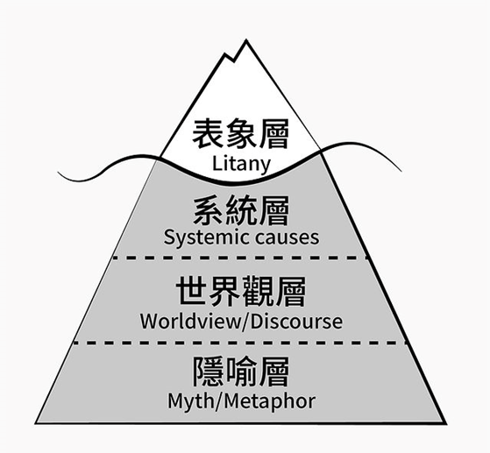
Checklist for revision
✓ Does the scene answer what happens, why, under which beliefs, and with a resonant myth?
Remember:
Deep Writing = Plot + Context + Worldview + Myth.
A single potent metaphor can transform a scene from shallow to profound.

Slide 12















Slide 13
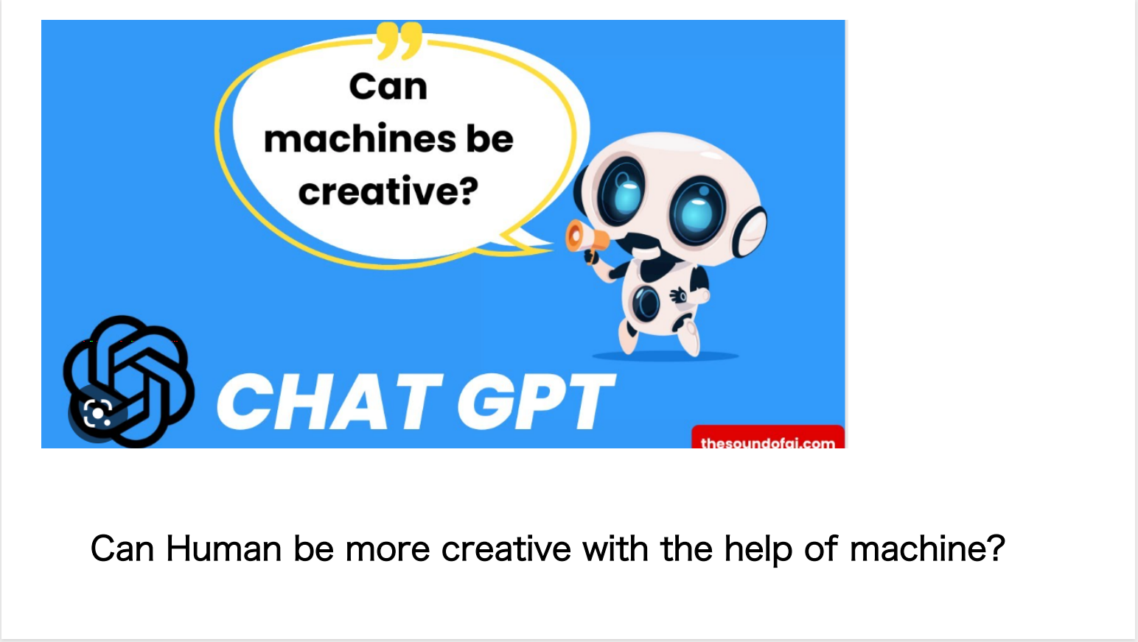

Slide 14
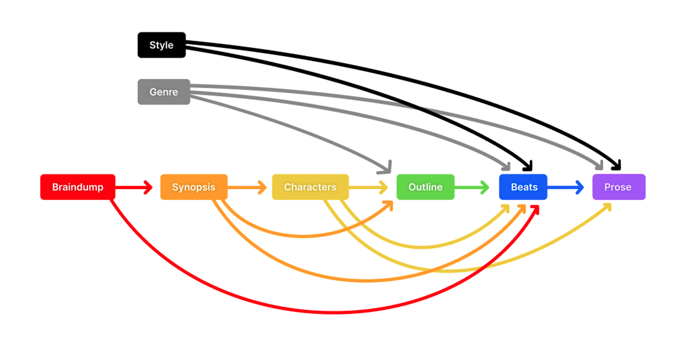
Multi Modality - How to feel?
Embodiment - How to interact?
Recursive - How to reflect?
Adversarial - How to revise?
Meta Cognition - How to improve?

Slide 15
Resource:
Deep Writing: A Hermetic Practice in the LLM Era (Chen Qiufan)
Inayatullah’s CLA framework (Intro chapter)

Slide 16
Thank you!
E-mail：scifivan@gmail.com

